Slide 1

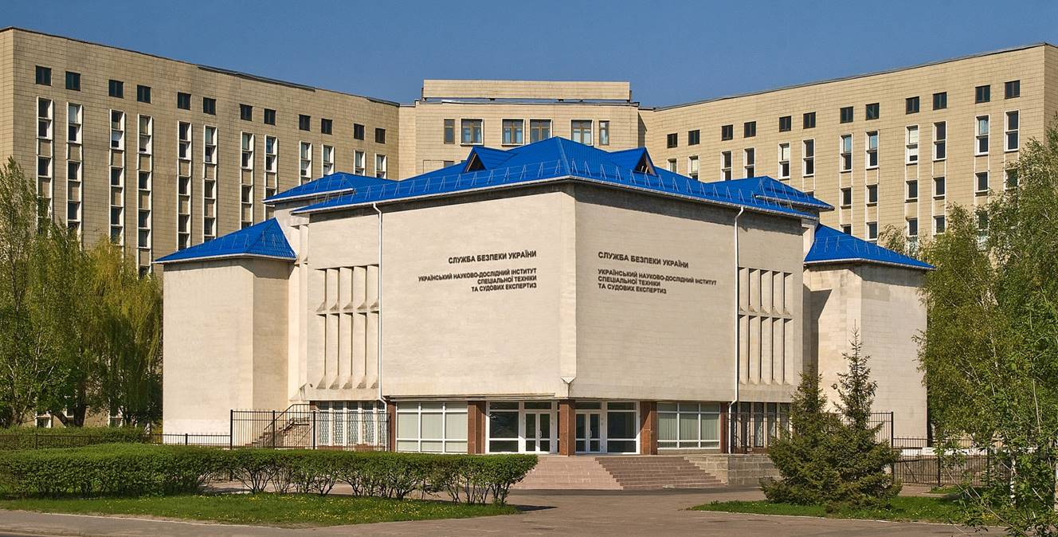
The Ukrainian scientific and research Institute of special equipment and forensic expertise of the Security Service of Ukraine
(ISEE SSU)

Slide 2
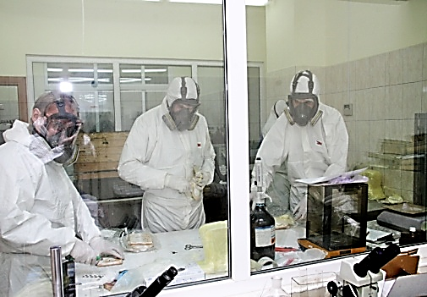
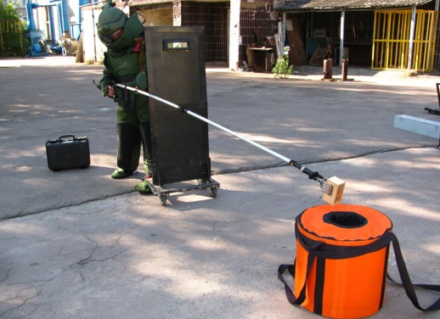
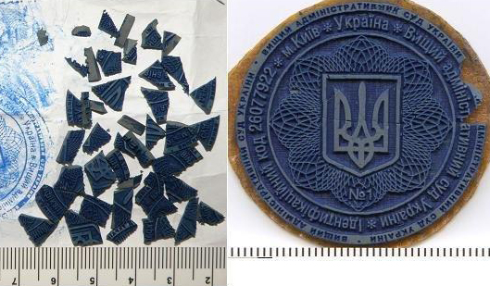
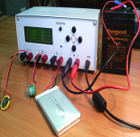
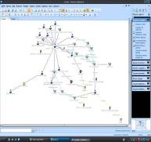
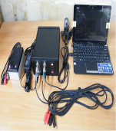
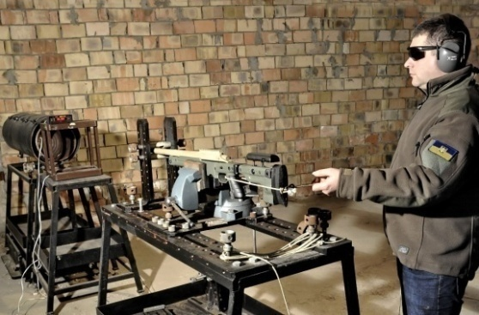
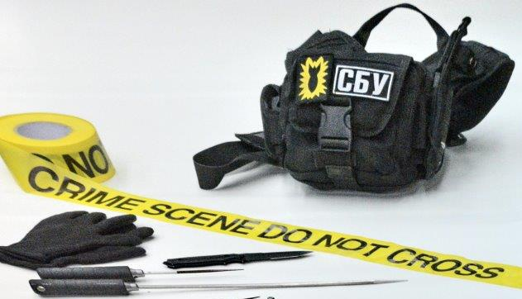
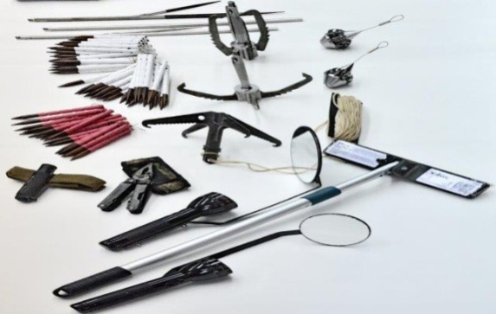
The main activities of the ISEE SSU
Forensic expert activity
Scientific and technical activity
Production activity

Slide 3
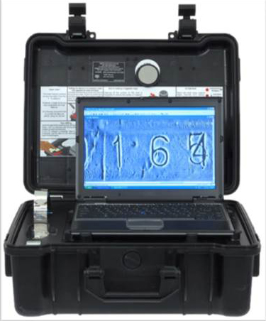
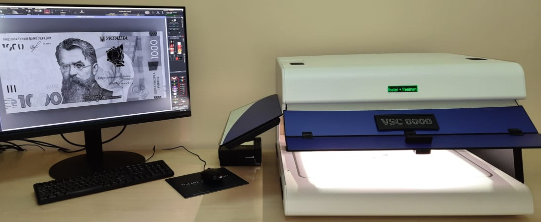
Forensic expert activity
The ISEE SSU conducts 36 types of forensic expertise in 98 expert specialties
Since 2021, ISEE SSU is a full member of ENFSI (European Network of Forensic Science Institutes)

Slide 4

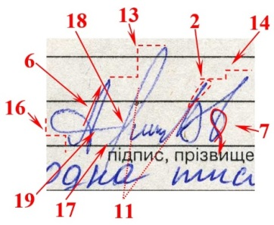
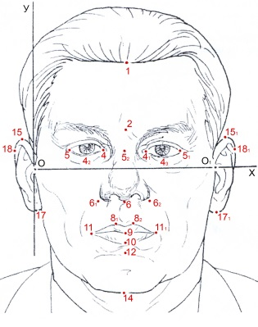

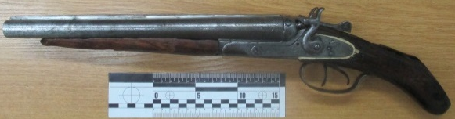



The ISEE SSU has the greatest experience in the following types of expertise:
- handwriting expertise
- linguistic expertise
- technical expertise of documents
- photo portraits expertise
- computer and technical expertise
- video and sound recording expertise
- drugs and psychotropic substances expertise
- firearms expertise
- explosive expertise
- economic expertise
- trasological expertise
- dactyloscopic expertise
Notes:
4

Slide 5
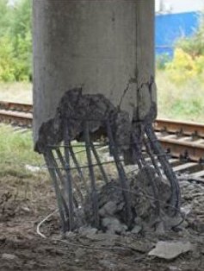
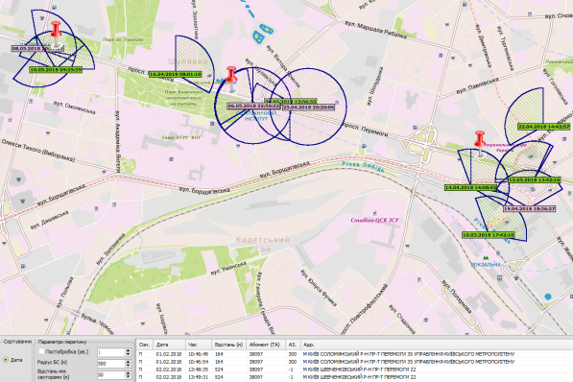

The ISEE SSU conducts forensic expertise that are unique. Which means that they are not provided in any other expert institution:
Аssessment of the consequences of the impact of technical factors of sabotage (terroristic acts) or other emergency sutation
Determination of the electronic device geolocation
Examination of the radio electronic equipment for reception, processing and transmission of information
Engineering and technological expertise of the objects of critical infrastructure.
Assessment of the possible consequences of the use of explosive devices
Examination of special technical means
Notes:
5

Slide 6
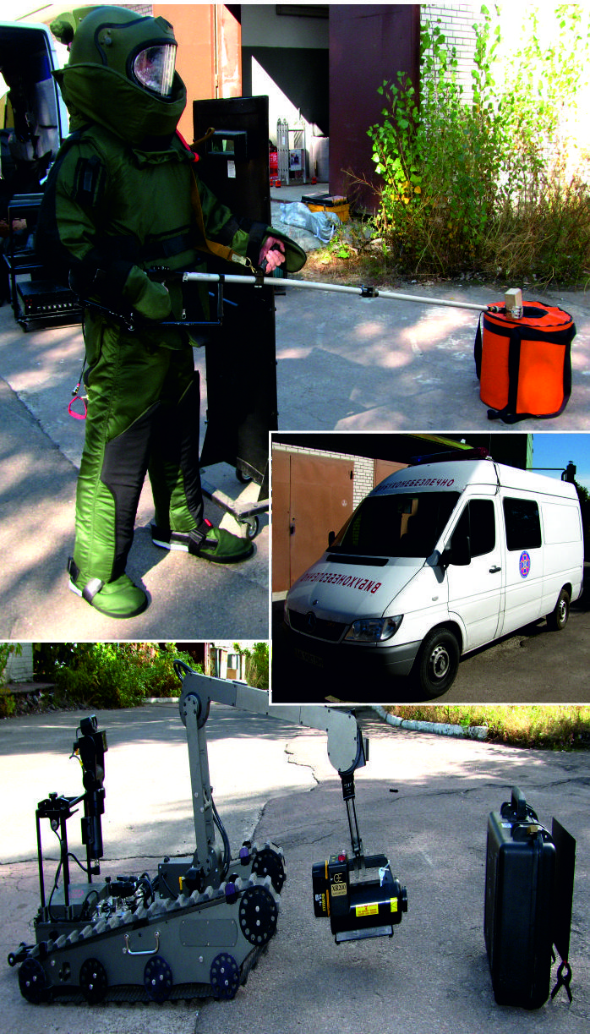
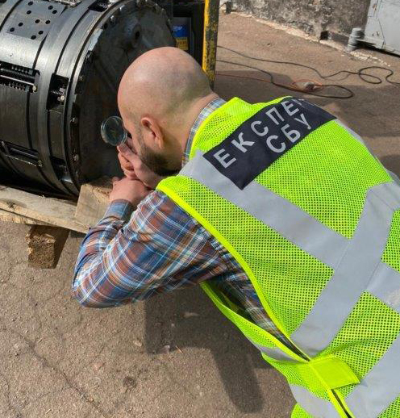
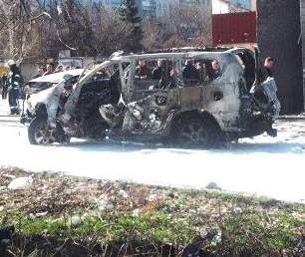
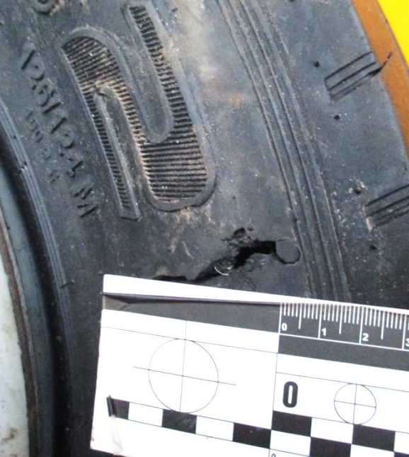
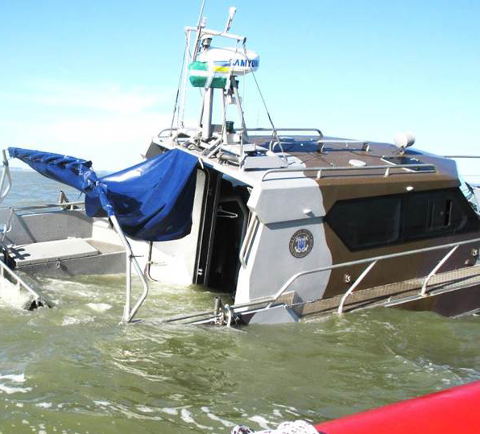
Crime scene investigation
technical forensic and explosive technical support of operational and investigative (search) measures
Notes:
6

Slide 7

THANKS FOR ATTENTION
And hope for further fruitful cooperation

