Slide 1
Ensuring a CBRN protection regime in the context of growing terrorist threats caused by the russian aggression in Ukraine

Slide 2
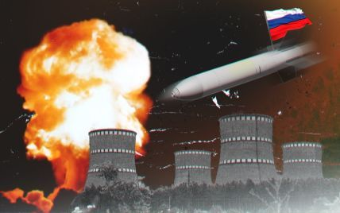
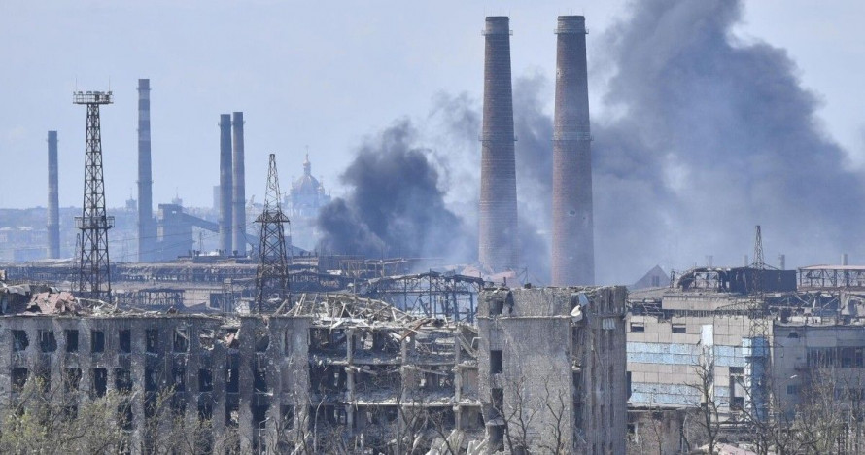
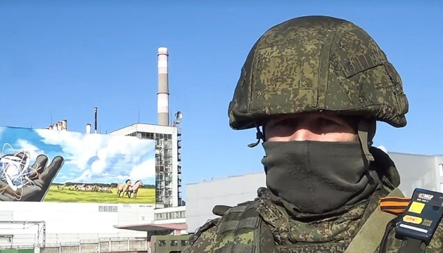
Since the beginning of the full-scale armed aggression of the russian federation, Ukraine faced a number of terrorist threats and challenges, caused by illegal proliferation of chemical, biological, radiological and nuclear (CBRN) materials and the system of their delivery:
аaggressor's armed forces caused devastating damage of the detection system of CBRN illegal transportation (especially, near the eastern border)
a great amount of industrial structures that used CBRN technologies stopped their business activity
control over protection and preservation of CBRN materials has become more complicated

Slide 3
Terrorist threat levels
REGULATIONS
on an Integrated national system of prevention, response and suppression
of terrorist attacks and minimization
of their consequences
ADOPTED
by the Resolution
of the Cabinet of Ministers
of Ukraine
of February 18, 2016, № 92
grey
(possible threat)
Shall be declared when factors
(conditions) conducive to terrorism exist.
blue
(potential threat)
If there is an information about preparation of a terrorist
attack that needs
to be confirmed.
yellow
(feasible threat)
If accurate (verified) information
about preparation for committing
a terrorist act is available.
red
(real threat)
When the terrorist attack
occurred.

Slide 4
Main tasks of the ATC
collects (in accordance with established procedure), summarizes, analyses and estimates information on state and trends of terrorism spreading in Ukraine and abroad, develops conceptual framework and programs of combating terrorism, as well as recommendations, aimed at efficiency improvements concerning measures of detection and elimination of conditions that contribute to conduction of terrorist acts or other crimes committed with terrorist purpose;
coordinates and organizes preparation of antiterrorist actors on conducting antiterrorist measures, gives methodological assistance and recommendations on detection and elimination of reasons and conditions, conducive to terrorism or other crimes committed with terrorist purpose;
develops propositions on legislation improvements in the sphere of combating terrorism.

Slide 5
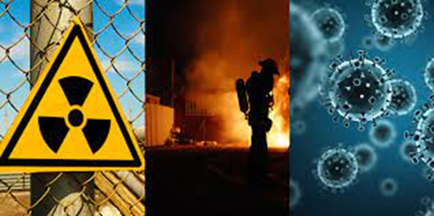
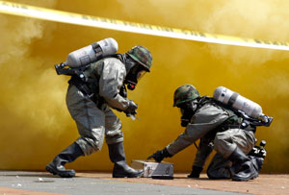
As a result of practical trainings (in the form of table-top, special tactical and field trainings) of Antiterrorist Center at the SSU that was dedicated to terrorist threats and challenges, the following problematic issuers in organization of antiterrorist protection of CBRN materials were detected:
negative impact of human factor in case of detection of suspicious CBRN materials and related people, inattention, insufficient level of special knowledge, practical skills, lack of response protocols;
underfunding of new and modernized means of detection, identification, signaling and communication;
insufficient material and technical supply of personnel protective equipment for those involved in reaction and liquidation of possible negative consequences;
absence of targeted financial support mechanism for modern means of detection, communication and individual protection on the state level;
gaps and legal conflicts concerning mechanism that regulates coordination of involved forces in case of detection of radioactive or nuclear materials trafficking.

Slide 6
Development prospects of combating CBRN-terrorism:
increase the level of operational reaction of combating radioactive, chemical, biological threats on conduction mass events (due to clusters: intelligence and control, monitoring, search, identification);
сcreation of functional unified system of notification and reaction in case of CBRN accident;
improvement of legal basis;
improvement of the expertise of subject matter forensics experts in order to develop abilities on examinations of detected CNRN materials that were in illicit trafficking;
organization of professional training of subject matter experts in the sphere of combating CBRN terrorism.

Slide 7
Thank You For Your Attention
© ATC HQ, 2023

