Slide 1
International CBRN Risk Mitigation Research Center’s activity, international cooperation in CBRN security and “Triglav” project

Slide 2
Threats and counteractions in CBRN field
What makes the CBRN threats
Counteractions to CBRN threats
Wars and armed conflicts (War with russia)
Weapons of mass destruction
Terrorism
CBRN materials smuggling
Industrial emergency incidents
International cooperation, data and experience exchange.
Knowledge level increasing
Practical trainings
An improvement of the CBRN threats combating and proliferation system
Material assistance
Raising the public awareness

Slide 3
International CBRN Risk mitigation Research Center and international cooperation
International CBRN Risk mitigation Research Center (hereinafter “Center”) is non-governmental and non-profit organization
Tasks:
Increase the legal culture of civil society in Ukraine in the field of CBRN risk mitigation;
Cooperation with domestic, foreign or international organizations, institutions, governmental authorities concerning CBRN risk mitigation;
CBRN database creation, assistance and improvement of the information, knowledge and best practice exchange between countries and international/regional organizations;
Priorities determination for training implementation in the field of CBRN risk mitigation;
Participation in the development, planning, and implementation of CBRN risk mitigation policies and procedures at regional and national level;
Assistance attraction and coordination for combat against illicit traffic of CBRNE materials.

Slide 4
International CBRN Risk mitigation Research Center and international cooperation
Activities:
Development and implementation of international scientific research projects intended to upgrade the system of combating the proliferation of CBRN threats.
Provision of consultations and information support, assistance for conduction and arrangement of trainings, round tables, seminars, conferences, engaging the public members, state and local self-governing authorities, experts in various fields of social life.
Conducting investigations for legal and legislative frameworks improvement, coordination of interested departments and organizations cooperation who acting in the field of CBRN risk mitigation.
Provision of practical assistance for law enforcement officers training, who involved into combat against illicit traffic of CBRNE materials.

Slide 5
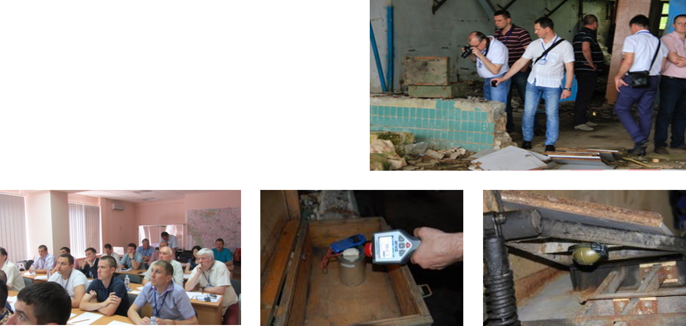
The Center has own training capacity and offering the wide range of training courses.
CBRN Courses (general):
Worldwide threat briefing
Domestic threat briefing
CBRN Terrorism Awareness
Chemical Agents
Biological Agents
Radiological Isotopes
Toxic Industrial Chemicals
Toxic Industrial Materials

Slide 6
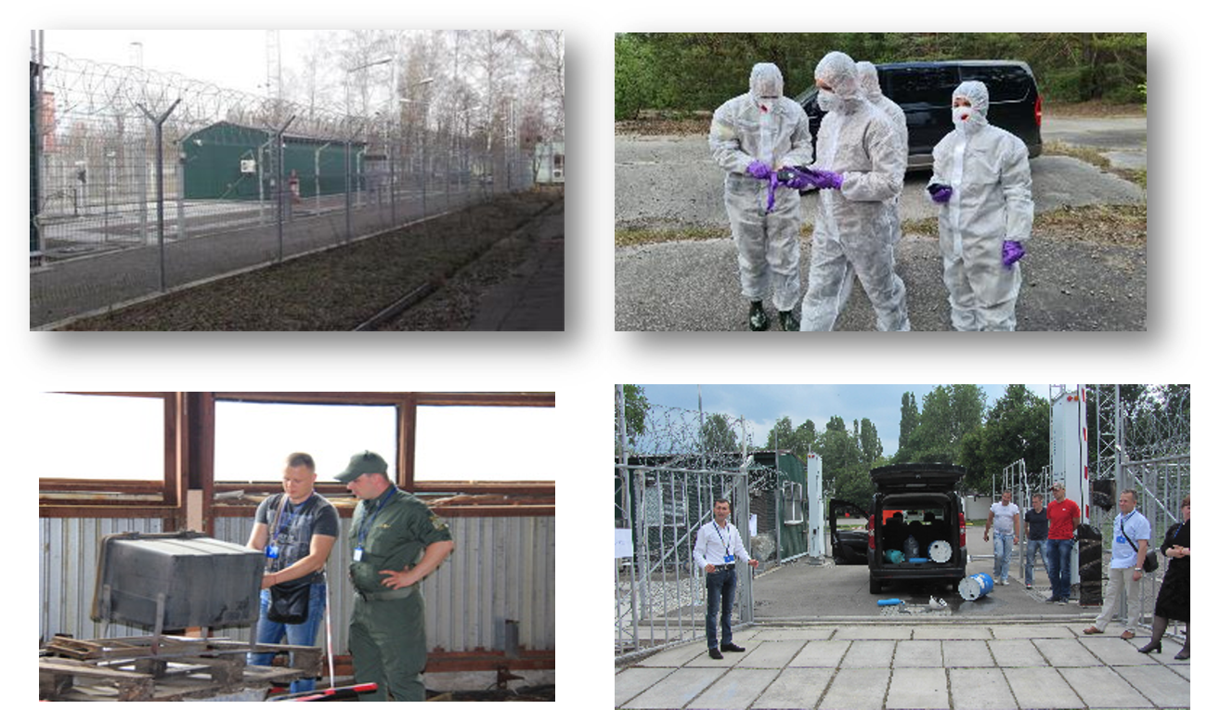
Center experience

Slide 7
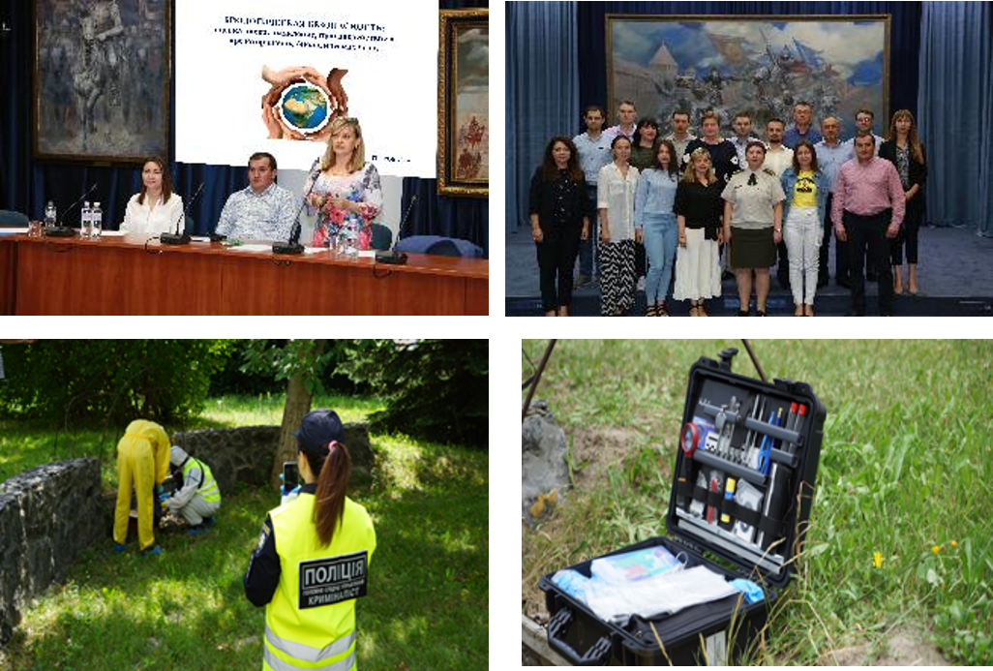
Project 57: Strengthening crime scene forensics capabilities in investigating CBRN incidents in the South East and Eastern Europe Centers of Excellence
The training workshop “Strengthening crime scene forensics capabilities in investigating CBRN incidents”
Dates: July 22 - 25, 2019, Place: L.I. Medved’s Research Center, Kyiv

Slide 8
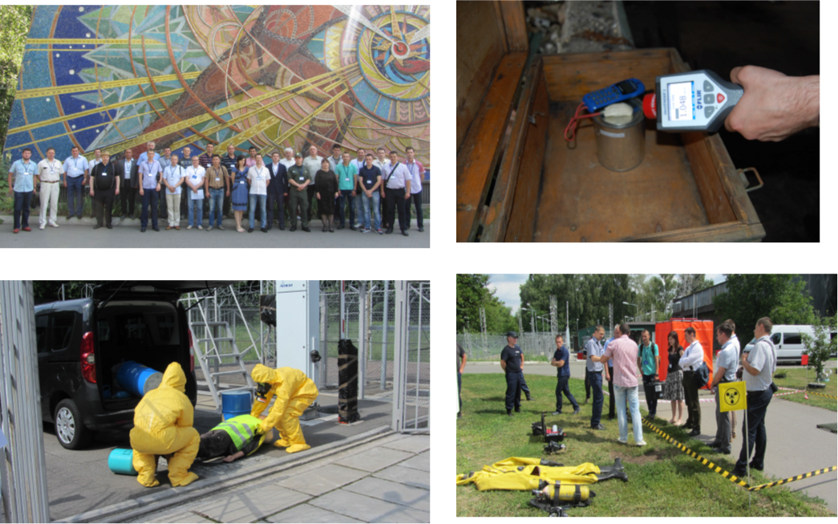
Project №44 «Improvement of the possibilities of the SWAT teams in the event of CBRN risk and regional cooperation in South-Eastern Europe, South Caucasus, Moldova and Ukraine
Practical training Dates: 26-27 of June, 2017 Place: Training Center for Physical Protection, Control and Accounting of Nuclear Material named after George Kuzmycz, Kyiv

Slide 9
Training in the Chornobyl Exclusion Zone
(May 2022)
Practice of practical skills of work in potentially contaminated areas with using Radiation pagers and hand held equipment on the example of trenches of the occupying Russian troops in the Red Forest. Servicemen learned to use personal protective equipment, rules for their disposal, and rules of conduct in potentially contaminated areas.

Slide 10
“Triglav” project as part of European and global CBRN security
“Triglav” project implementation improves the CBRN threats counteraction abilities and has positive influence on:
Preparedness for the CBRN threat;
Proper reaction abilities and capabilities;
Cross-Border information exchange;
Possibilities of joint actions at the border area;
Through abovementioned influence the “Triglav” project improves the global CBRN security because CBRN incident does not distinguish and it‘s consequences are not stopped by the state borders

Slide 11
International CBRN Risk mitigation Research Center’s main tasks and responsibilities within framework of “Triglav” project
Implementation of Joint Concept of Operation in practice
Development and formalization of CBRN defense education and training system
International exercises
Education and Training
Equipment procurement

Slide 12
Why we do it?
To achieve the project goals:
Improvement of cooperation between Ukrainian and Slovakian authorities involved in the project for fight against illegal handling of CBRN materials
Increasing the knowledge and skills level of employees of authorities involved in the project
Improving the technical equipment of authorities competent to fight against illegal handling of CBRN materials
Raising the state administration employees awareness of criminal activities related to the threats posed by misuse of hazardous CBRN materials
Raising the public awareness of the threats posed by misuse of hazardous CBRN materials

Slide 13
Thank you for your attention!
Address: Kropyvnytskoho str. 14, office 9 Kyiv, 01004, Ukraine Phone: +38 (044) 537-01-55 E-mail: info@cbrn.center

