Slide 1
The EEA and Norway Grants
Norwegian Radiation and Nuclear Safety Authority (DSA)

Slide 2
Content
What is the EEA?
Why the Grants exist?
About the Grants
How much the Grants worth?
What is the difference between the EEA Grants and the Norway Grants?
The EEA Grants
The Norway Grants
Questions and Answers

Slide 3
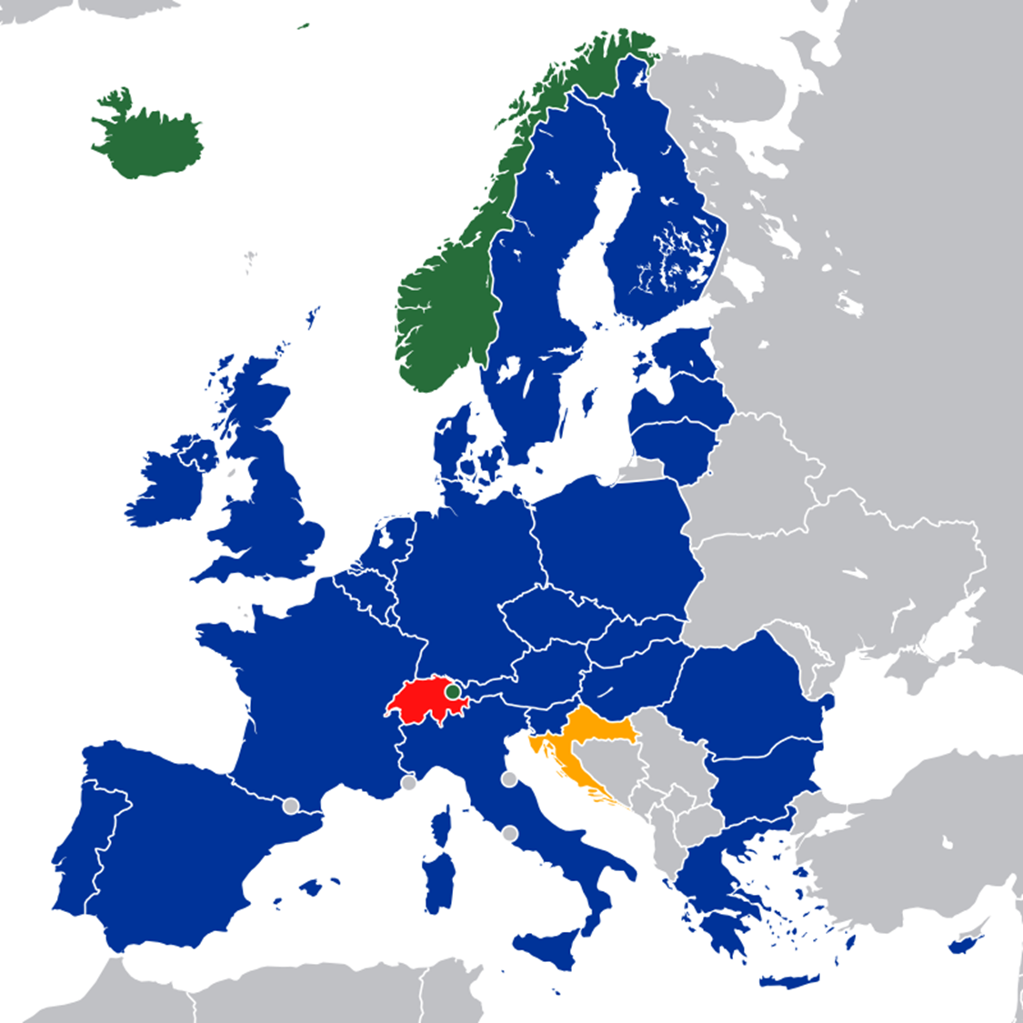
What is the EEA?
The European Economic Area binds together the 28 EU member countries and Iceland, Liechtenstein and Norway as equal partners in the internal market.

Slide 4
Why the Grants exist?
The EEA and Norway Grants have their basis in the EEA Agreement. Under this agreement, Iceland, Liechtenstein and Norway are part of the European internal market. The agreement sets out the common goal of working together to reduce social and economic disparities in Europe and strengthening cooperation between European countries. For this purpose, the EEA and Norway Grants have been established.

Slide 5
About the Grants
The EEA and Norway Grants are funded by Iceland, Liechtenstein and Norway. The Grants have two goals – to contribute to a more equal Europe, both socially and economically – and to strengthen the relations between Iceland, Liechtenstein and Norway, and the 15 Beneficiary States in Europe.
https://eeagrants.org/

Slide 6
How much are the Grants worth?

Slide 7
What is the difference between the EEA Grants and the Norway Grants?
The Grants are composed of two funding schemes – the EEA Grants and the Norway Grants. The main difference between the two lies in where the funding comes from, and which countries receive the funding.

Slide 8
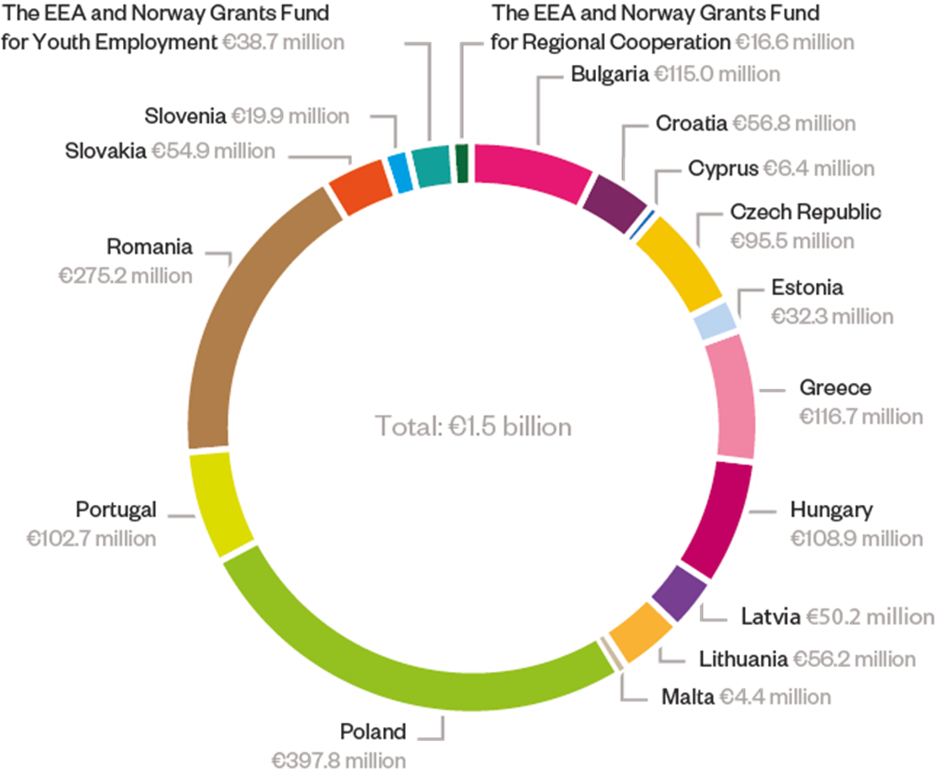
The EEA Grants

Slide 9
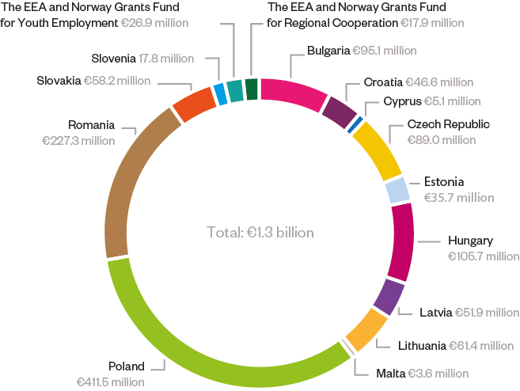
The Norway Grants

Slide 10
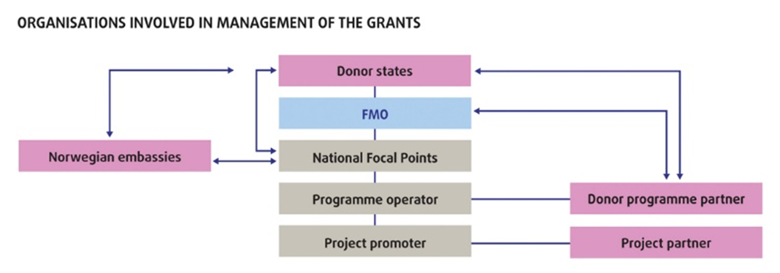
Management of the Grants

Slide 11
Questions and Answers
The official website of the EEA and Norway Grants is: https://eeagrants.org/

