Slide 1
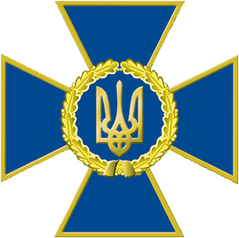
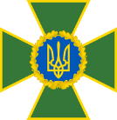
Capacities and Capabilities of the Norwegian Radiation and Nuclear Safety Authority (DSA)

Slide 2
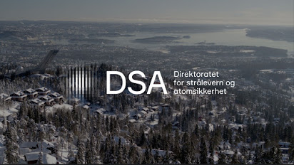
Content
About DSA
Measurement capacities
DSA’s International Cooperation
Questions and Answers

Slide 3
About DSA - Remit
The Norwegian Radiation and Nuclear Safety Authority (DSA) is the national authority and expert body in matters concerning nuclear safety, radiation use, natural radiation and radioactive contamination in the environment.

Slide 4
About DSA – Societal mission
DSA strives to reduce the negative consequences of radiation by ensuring that the handling of radiation sources, radioactive waste and discharges, medical radiation use, and closure and clean-up of nuclear facilities (decommissioning) are carried out correctly and responsibly. We strive to reduce exposure to natural radiation from radon and UV. We are also responsible for managing exposure from electromagnetic fields.
We also strive to improve nuclear safety internationally and to prevent the dispersal of radioactive material.
We carry out our societal mission through administering regulations, conducting surveillance, guiding, informing, providing advice and managing knowledge.

Slide 5
About DSA - What we do
The Norwegian Radiation and Nuclear Safety Authority (DSA):
is the national authority for nuclear safety in Norway and the expert body concerning concessions for nuclear facilities;
oversees all use of radiation sources within medicine, industry and research including the two research reactors in Norway;
monitors natural and artificial radiation in the environment and working life;
has a comprehensive bilateral project collaboration with other countries.
conducts R&D;

Slide 6
About DSA - What we do
chairs and serves as the secretariat for nuclear preparedness in Norway;
has 24/7 EPR capabilities for handling of RN events;
has a national reference laboratory for measuring radiation doses and radioactivity on behalf of the Ministry of Justice;
participates in the Centre for Environmental Radioactivity (CERAD), which has been designated a Centre of Excellence by the Research Council of Norway.

Slide 7
About DSA - Organisational affiliation

Slide 8
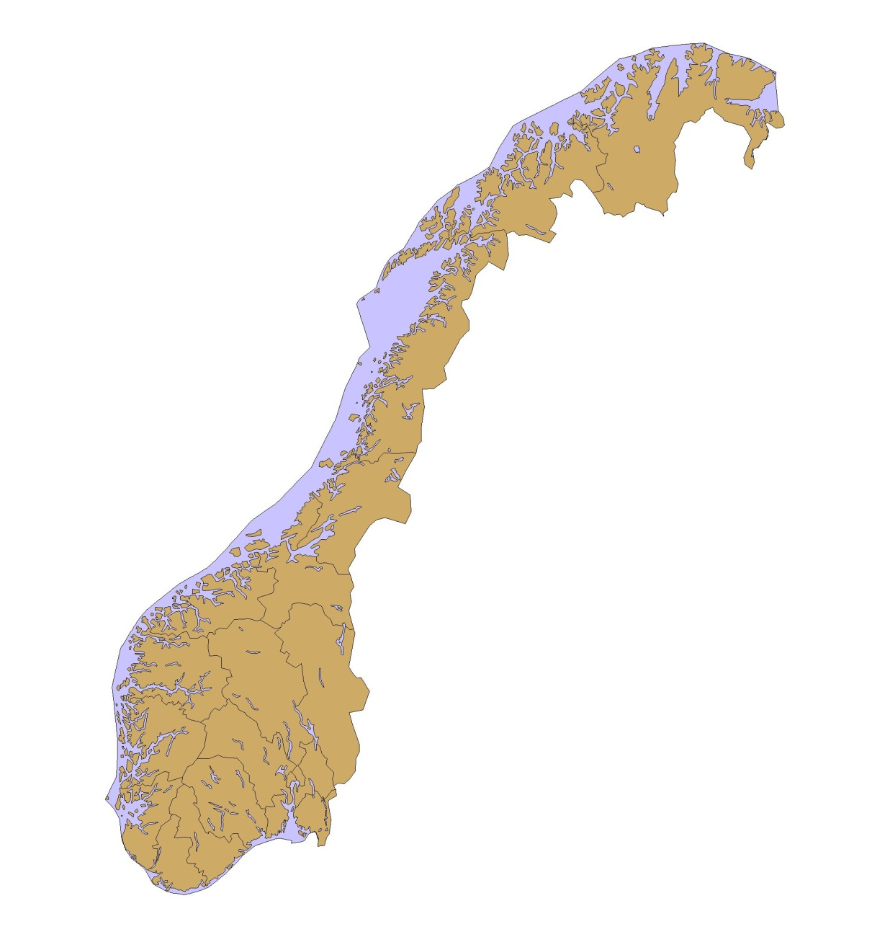
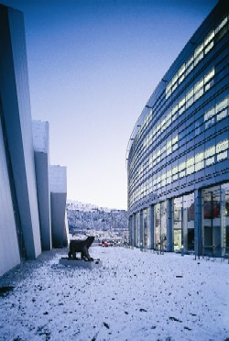
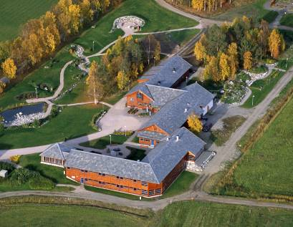
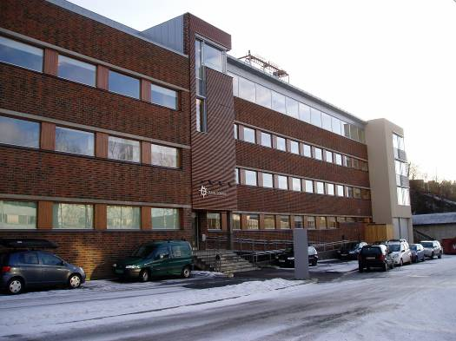
About DSA - Offices and Laboratories
Section High North, Svanhovd
Section High North, Tromsø
Main Office, Østerås

Slide 9
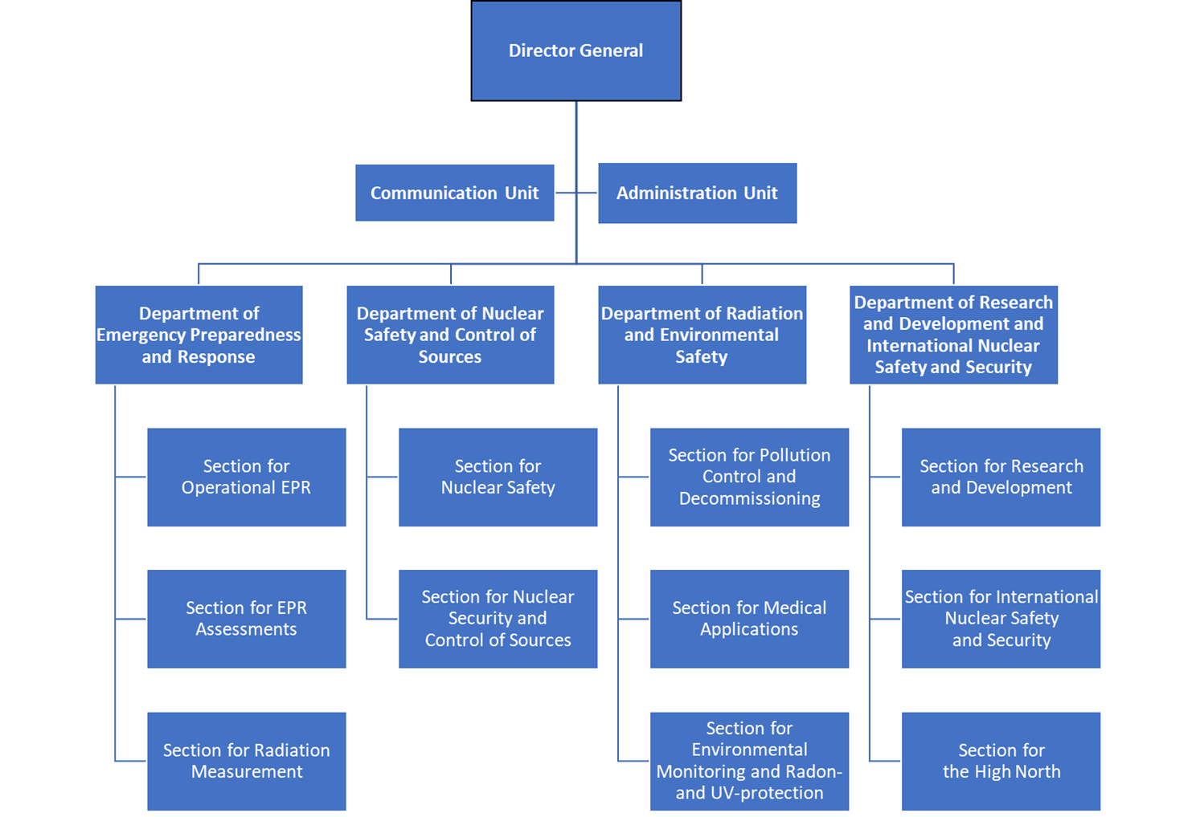
About DSA Organization Chart

Slide 10
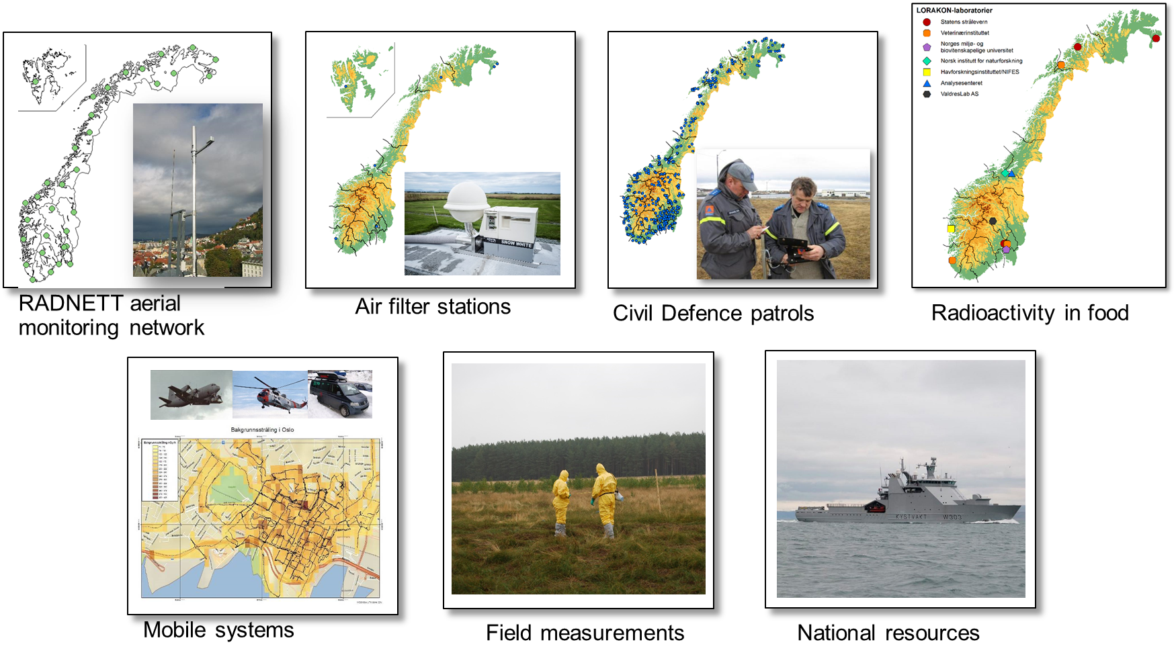
Measurement capacities

Slide 11
DSA’s international cooperation I.
Norwegian Government’s Nuclear Action Plan 2018-2022
Cooperation with relevant authorities and organizations​
Emergency preparedness​
Environmental monitoring​
Non-proliferation and physical security​
Nuclear power plants​
Spent nuclear fuel and radioactive waste​
Radioactive sources​

Slide 12
DSA’s international cooperation II.
Strengthened cooperation with Ukraine
Regulatory cooperation DSA-SNRIU​
Initiatives at Nuclear Power Plants – Rivne and Khmelnitsky​
Nuclear Waste Chornobyl and Pridniprovsky Chemical Plant​
Emergency preparedness ​
UNICRI
Regional cooperation and information sharing on RN trafficking in the Black Sea Region (Georgia, Moldova and Ukraine).

Slide 13
EEA and Norway Grants projects 2019 – 2024 I.
TRIGLAV – Strengthen the fight against CBRN threats at the Slovakian-Ukrainian border (Slovakia/Ukraine)
Enhancement of Nuclear Safety and Security in Romania – Improvement of Disaster Resilience and Preparedness for Radiological and Nuclear Events (Romania)

Slide 14
EEA and Norway Grants projects 2019 – 2024 II.
Safety Enhancement of Ignalina NPP Radioactive Waste management (Lithuania)
Development of an early warning system on nuclear emergency (Lithuania)

Slide 15
Questions and Answers
The official website of the DSA is:
https://dsa.no/en

